Slide 1




ChromaCode: A Fully Imperceptible Screen-Camera Communication System
Kai Zhang*, Chenshu Wu^, Chaofan Yang*, Yi Zhao*,
Kehong Huang*, Chunyi Peng†, Yunhao Liu*‡, Zheng Yang*
*Tsinghua University, ^University of Maryland College Park,
†Purdue University, ‡Michigan State University
ACM MobiCom 2018@New Delhi, India

Slide 2
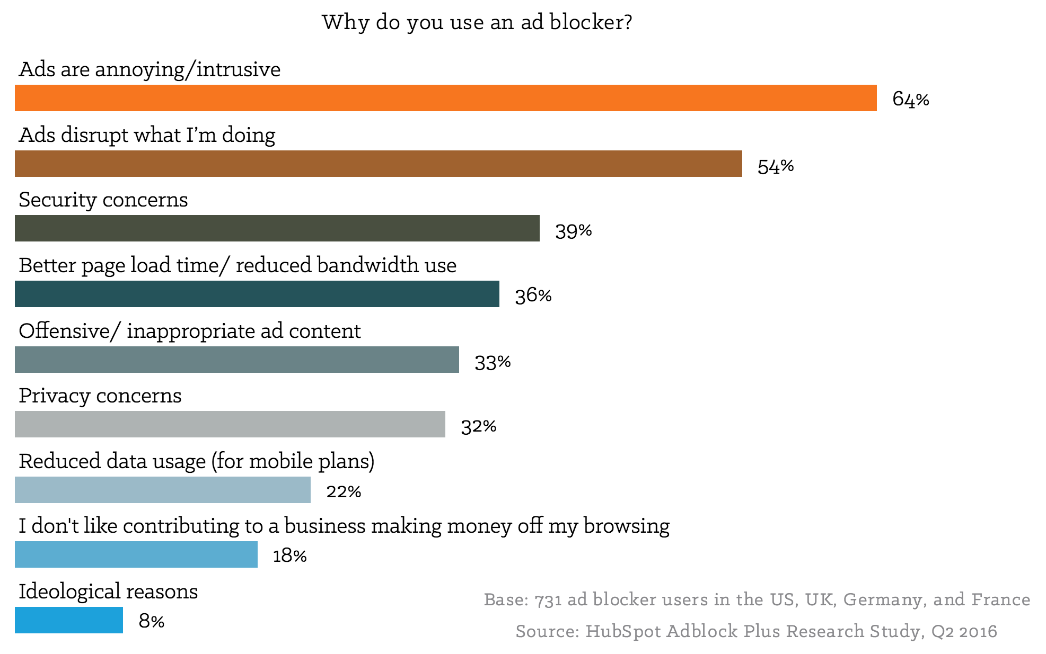
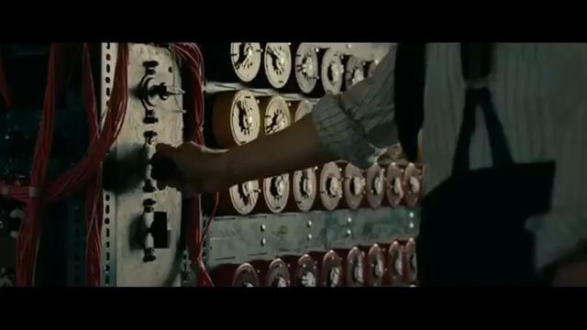

Simultaneous Viewing and Communication
65% of people skip online video ads, mainly due to the intrusiveness
QR code embeds extra info, yet still affects viewing experience
Making ads and other info invisible to viewers?
Notes:
Currently, it is reported that 65 percent of people skip online video advertising, mainly due to the intrusiveness. Delivering advertising content as side information without tampering primary video itself will not only guarantee viewing experience but also enhance user interaction. A common real-life example towards this paradigm is QR code. QR code spatially occupies a small area in the corner of a screen, and has extra information embedded inside. However, QR code is obtrusive for viewing and affects viewing experience. They may overlay important original video contents, especially in small monitors with limited screen spaces. QR code is mainly used for device-to-device communication, and is meaningless to human eyes.
What we hope is to make advertisements and other information invisible to viewers, to achieve simultaneous viewing and communication without affecting viewing experience.

Slide 3
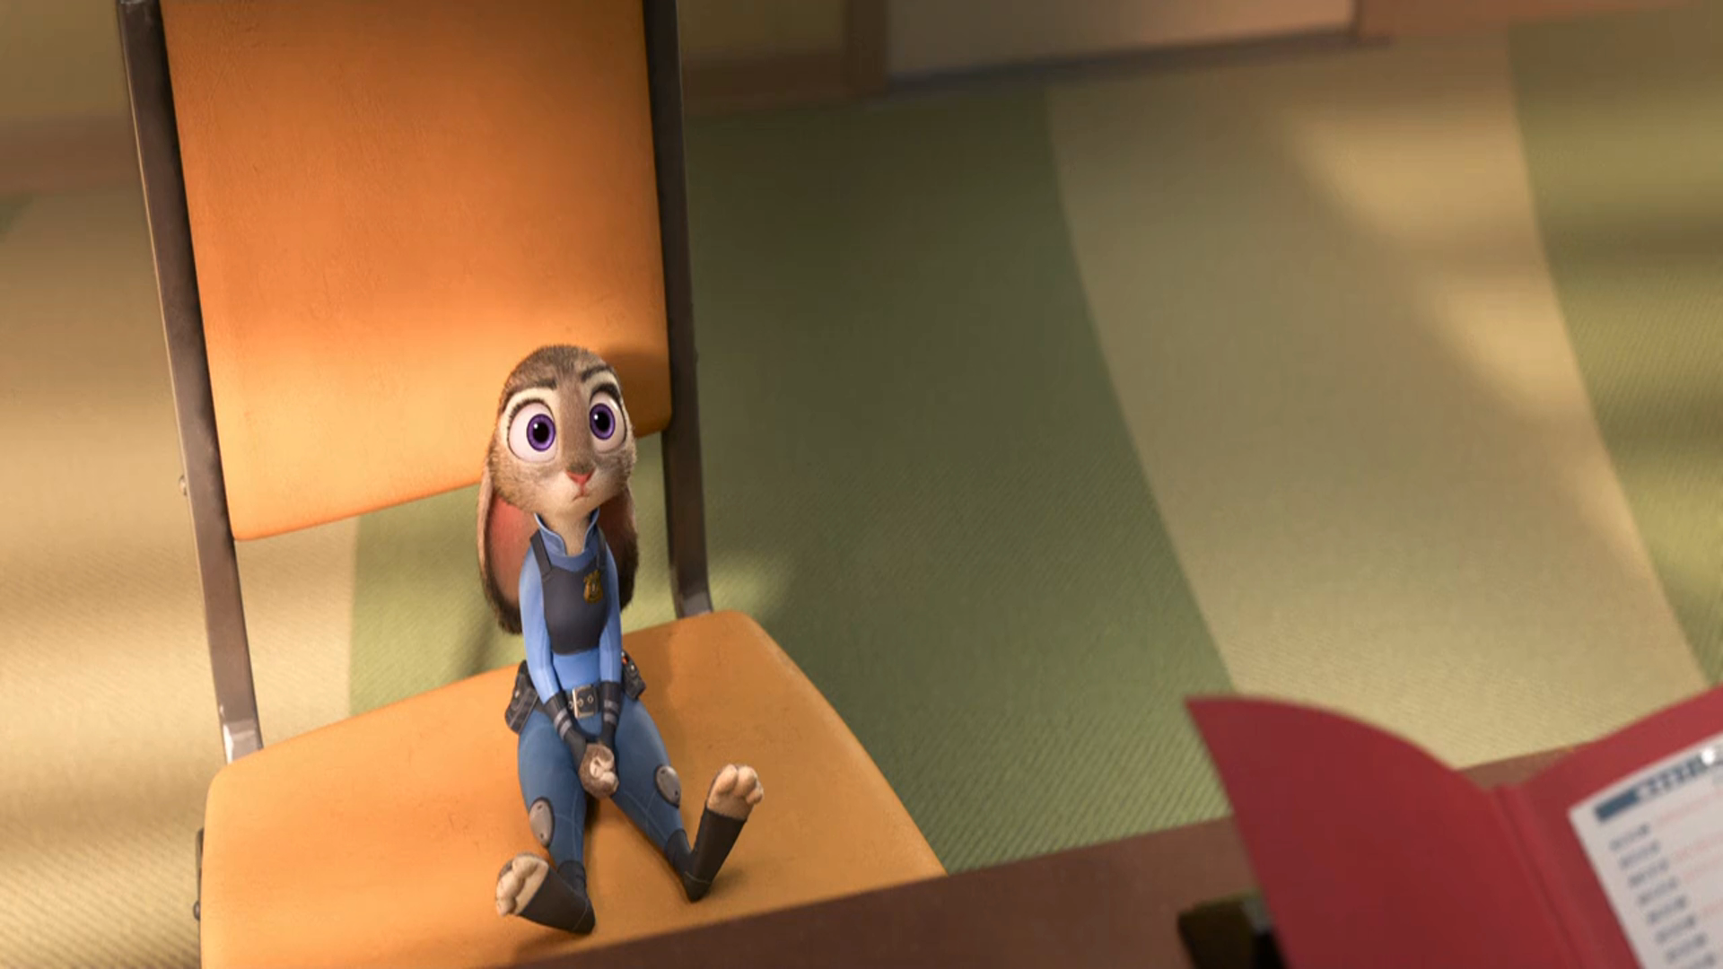


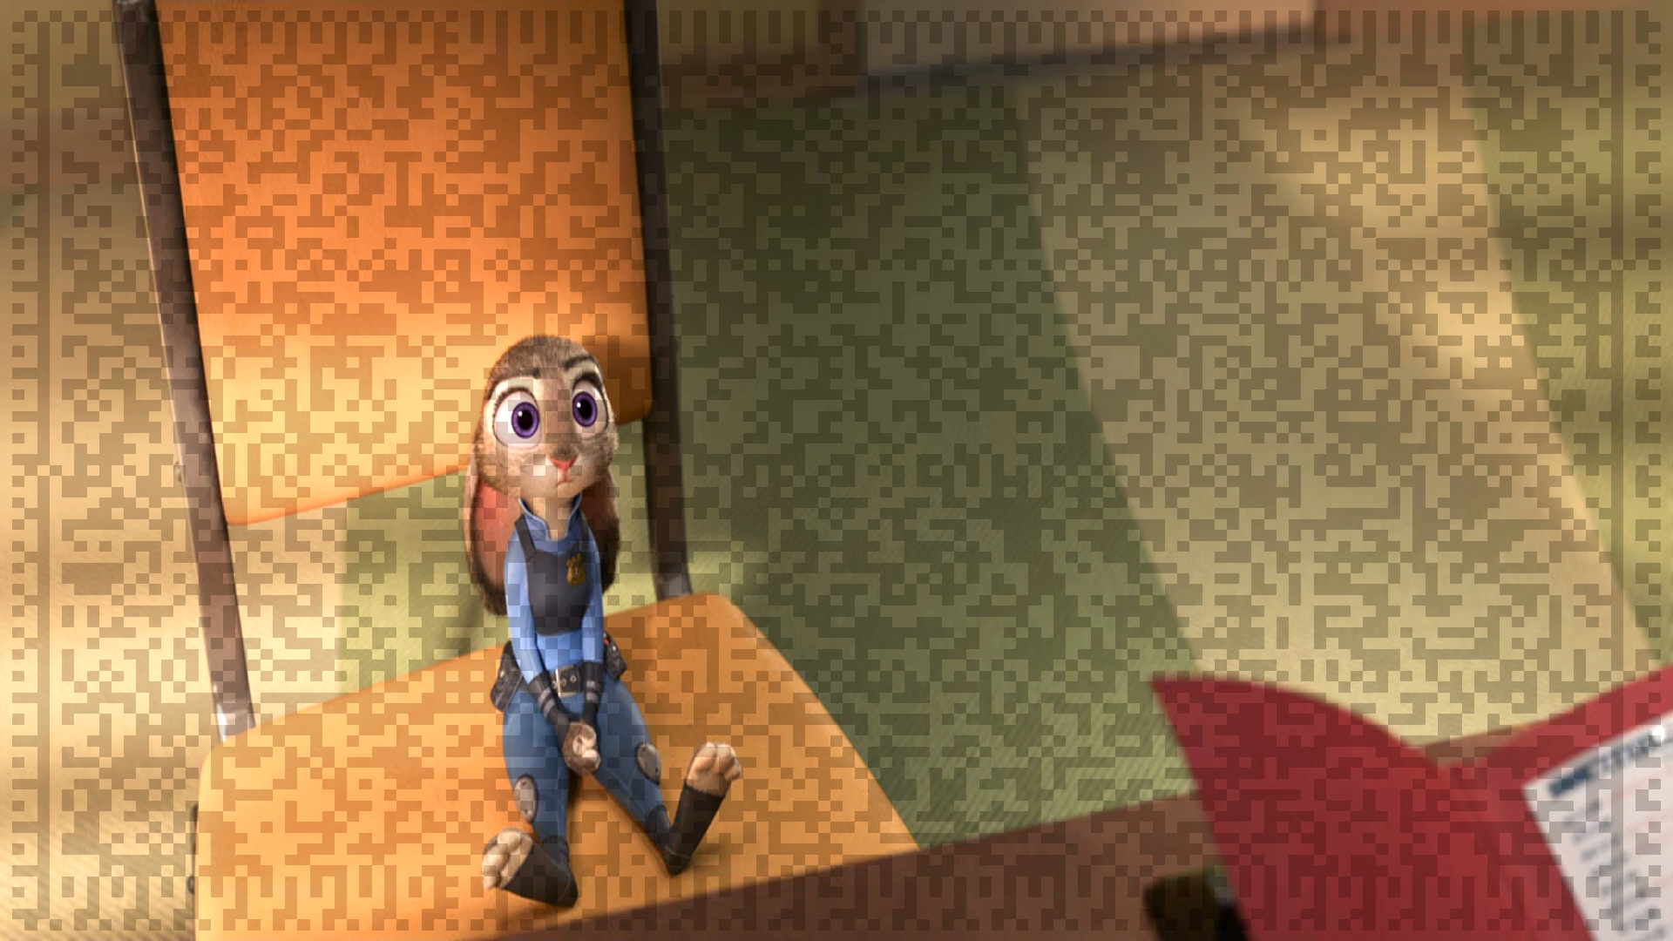
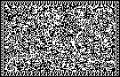

Hidden Screen-Camera Channel
Embed data into high frame rate primary videos unobtrusively
Flicker-fusion property
High capture rate
Notes:
This necessitate enabling hidden screen-camera channel. We hope to embed data frame into primary videos unobtrusively.
So that when the video is being played, human eyes cannot percept the embedded data frame. Human eyes can only see the origin video content. But the data frame embedded in the video can be captured with a camera, and then decoded.

Slide 4
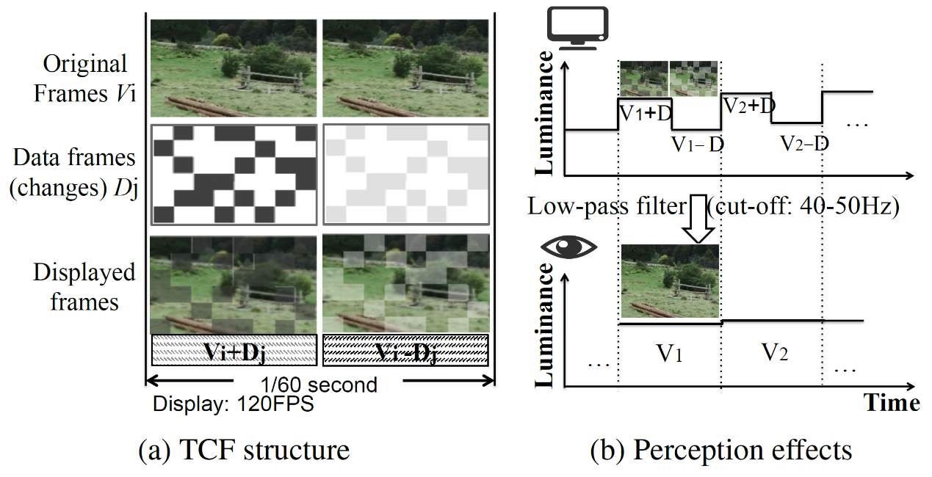
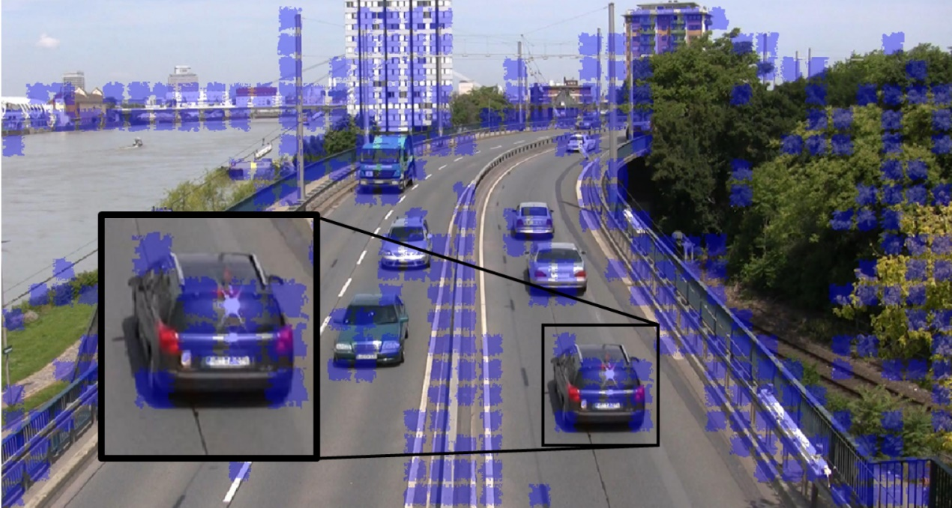
Related Works
InFrame, InFrame++
ImplicitCode
HiLight
TextureCode
Uber-in-Light
InFrame, InFrame++
TextureCode
Notes:
Related works have been made to enable hidden screen-camera communication. For example, InFrame++ leverages low-pass flicker fusion property of human eyes and achieves hidden data frame embedding by complementary lightness modification. TextureCode only embeds in textured regions to improve data frame invisibility.

Slide 5
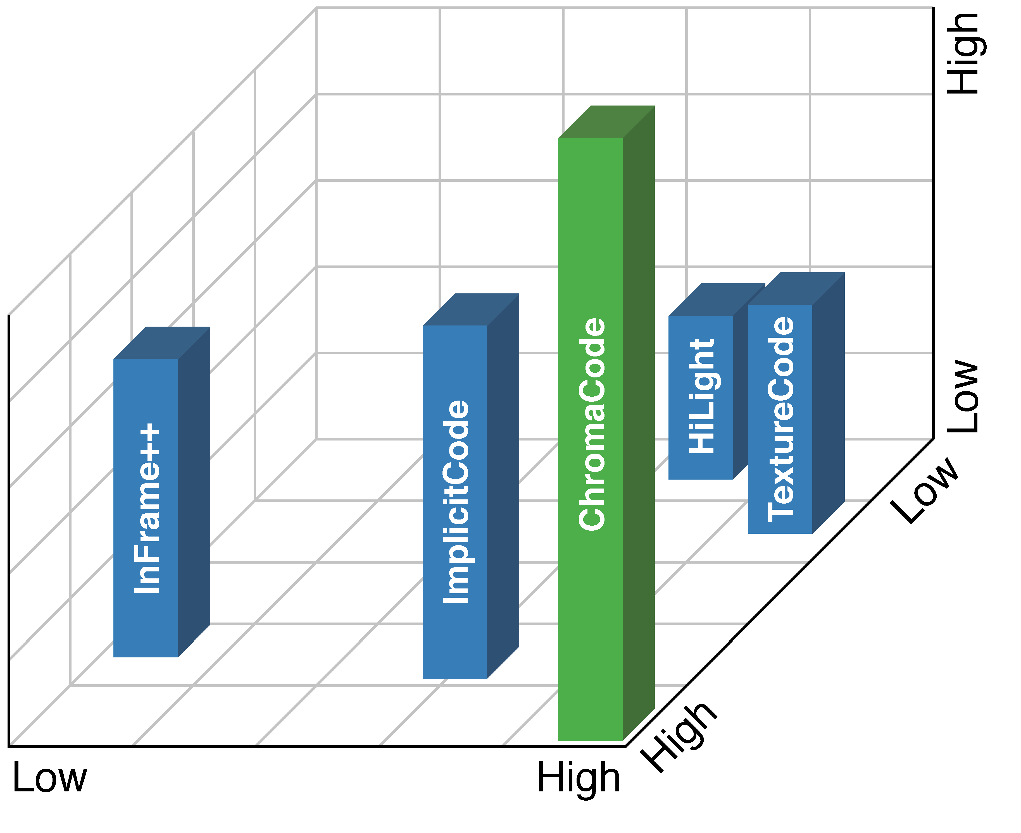
Three Conflicting Key Goals
Three key goals on imperceptible, high rate, and reliable communication are desirable but conflicting.
Previous works usually made a trade-off among them.
Reliability
ChromaCode achieves all three goals while retaining watching experience to users.
Throughtput
Invisibility
Notes:
There are mainly three key goals in hidden screen-camera communication. They are
Invisibility,
Reliability
And throughput.
However, these three key goals can be conflicting. For example, we can increase lightness adjusting amount to achieve more reliable data transmission, but more flickers may be observed by human eyes. Previous works usually made a trade-off among them. In our work, ChromaCode aims to achieve all three goals while retaining watching experience to users.

Slide 6
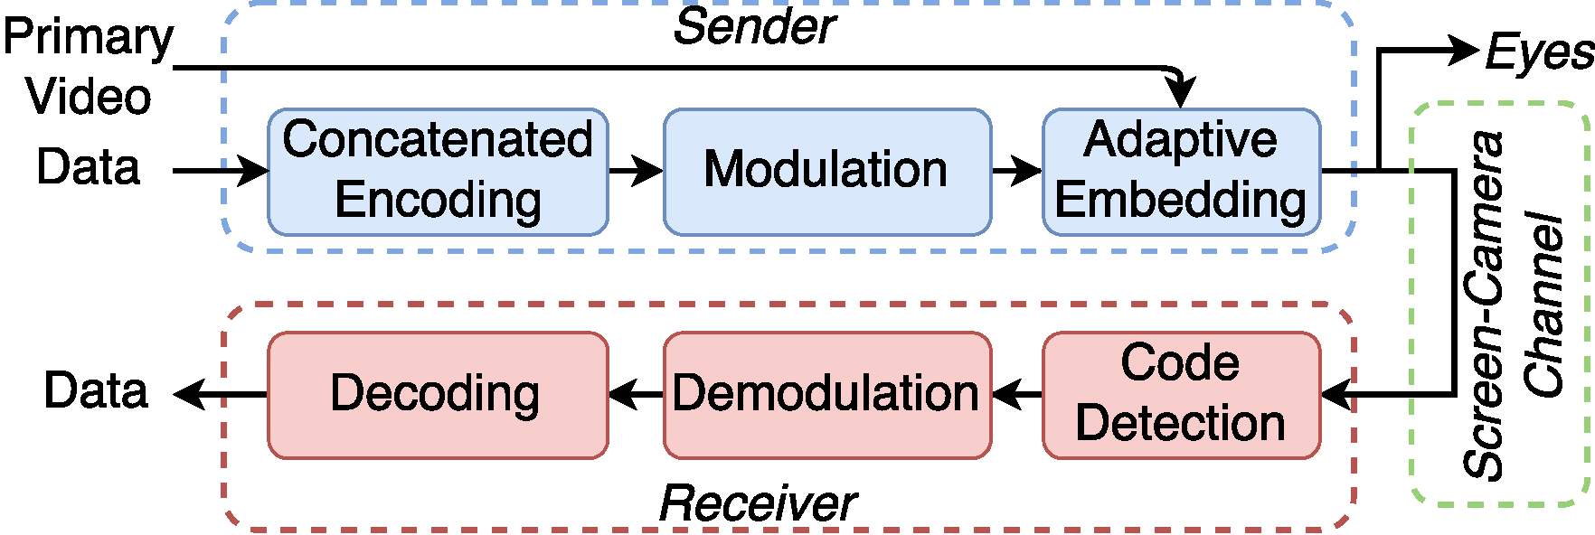
Overview
ChromaCode overall architecture
Notes:
This slide shows the overall architecture of ChromaCode.
Origin data is encoded through concatenated encoding
And then modulated to generate data frame.
The data frame is then embedded into primary video with adaptive embedding, so that when the video is being played
Human eyes can only see origin video contents.
But cameras can capture the embedded data frame
And then retrieve embedded data by demodulation and decoding.

Slide 7
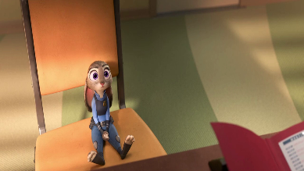
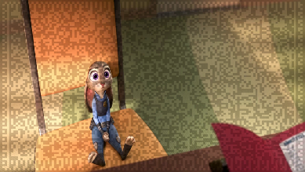

Hidden Screen-Camera Channel
Hiding data frame from human eyes is achieved by complementary lightness modification.
V
V+D
Flicker fused
D
V-D
Both captured
Complementary frames
But the hiding quality is not good enough in related works.
Notes:
Firstly let’s review how hidden screen-camera channel is achieved.
This is achieved by leveraging low-pass flicker fusion property of human eyes. Human eyes can not see flicker with frequency larger than 100Hz, but instead can only see the average lightness. So we can generate high frame rate complementary frames by complementary lightness modification to embed data frames unobtrusively into origin video. But the data frame can stilled be captured with high capturing rate cameras.
However, the hiding quality is still not good enough in related works.

Slide 8
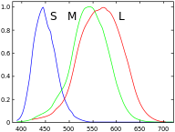
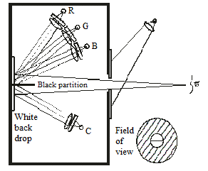
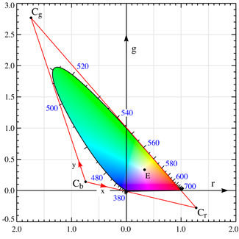
Color space preliminaries
Color spaces are models for human vision system.
CIERGB color space was built from human eyes experiments.
CIERGB has chromaticity distributions in negative axis.
Three kinds of cone cells in human eyes
Experiment to build RGB color space
CIERGB chromaticity space
Notes:
We achieve fully imperceptible data frame embedding firstly with some color space studies. Colors are not objective existence, but are perception in visual center of human brain. To show colors in electronic devices, color spaces are developed to model human vision system. There are exactly three kinds of cone cells in human eyes, shaping the trichromatic human vision system. The first color space CIERGB was built from human eyes experiments. However, CIERGB has chromaticity distributions in negative axis, which leads to inconvenience for calculation.

Slide 9
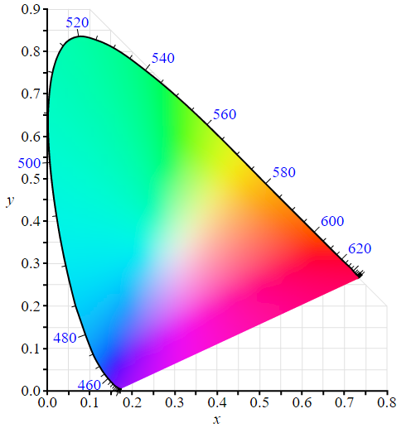
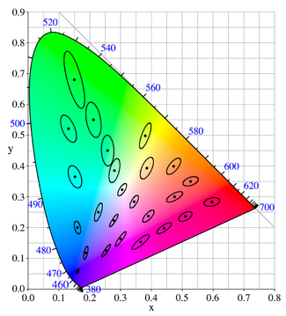
Color space preliminaries
CIEXYZ chromaticity space
MacAdam ellipses on CIEXYZ
CIEXYZ color space was built by linear transforming CIERGB color space.
MacAdam ellipses prove CIERGB, CIEXYZ and all their linear transformations non-uniform.
Notes:
To handle the problem above, CIEXYZ color space was built by doing linear transformation to CIERGB color space. MacAdam ellipses are obtained from human eyes experiments in CIEXYZ color space. Each ellipse is a region which contains all colors that are indistinguishable to human eyes, while colors outside of the ellipse are distinguishable from the color at the center of the ellipse. However, as the obtained curves are ellipses instead of circles, they prove that color differences are not in proportion to Euclidean distances of color vectors in CIEXYZ color space. Thus CIERGB, CIEXYZ, and all other color spaces built from linear transformation of them are non-uniform. To overcome this, efforts were made for decades to obtain uniform color spaces.

Slide 10
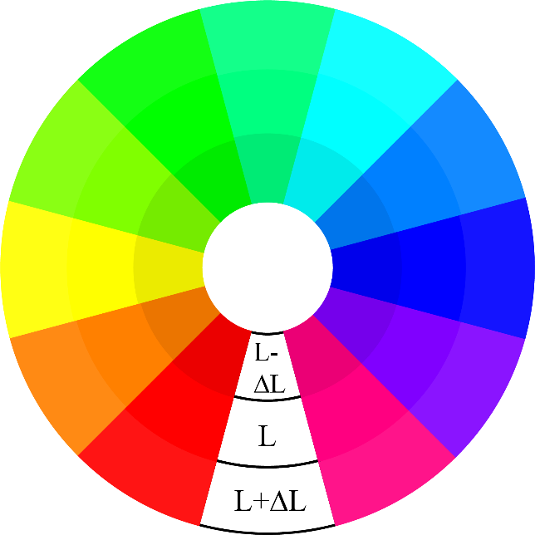
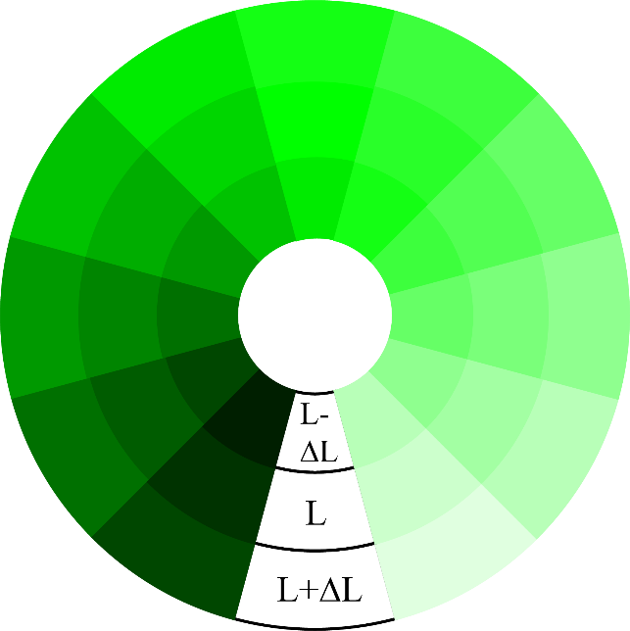
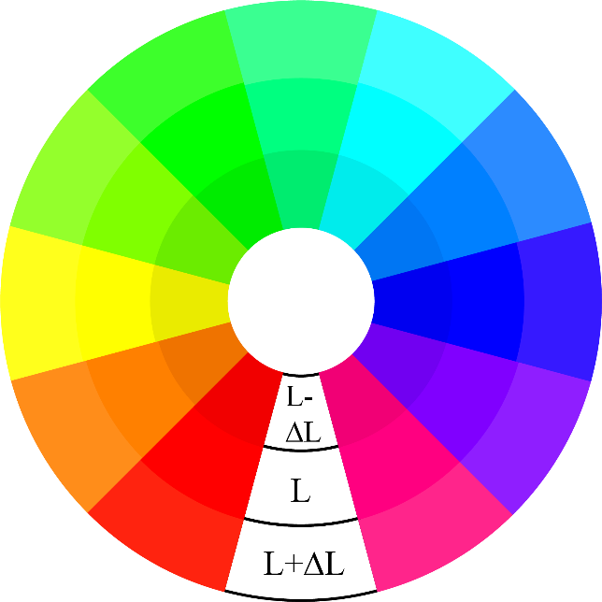
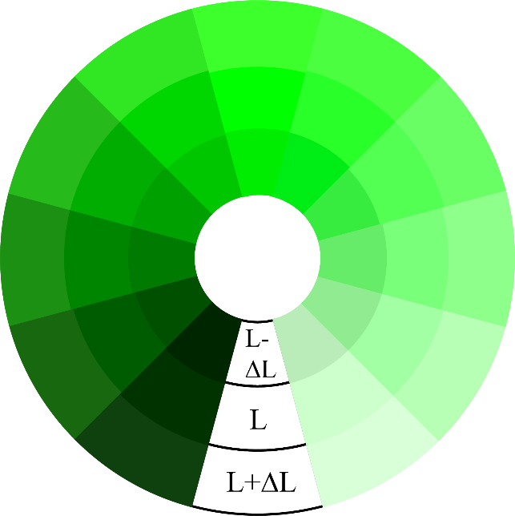
Achieving Fully-Imperceptible
Color space selection
Hue and lightness palettes in non-uniform color space
Hue and lightness palettes in uniform color space
While color differences are not obvious here.
Color differences are more perceptively uniform!
Uniform color spaces suit human vision system better.
Therefore we choose uniform color spaces.
Color differences are obvious here.
Notes:
We compare differences between non-uniform and uniform color spaces with their hue and lightness palettes.
There are three annuluses in each color palette. The middle annulus has lightness L. The outer and inner annuluses have lightness L+ΔL and L-ΔL. For the palettes in non-uniform color space, color differences are not uniform.
For example, color differences are more obvious here.
While color differences are less obvious here.
For palettes in uniform color space,
The color differences are more perceptively uniform.
Uniform color spaces suit human vision system better. Therefore we choose uniform color spaces for lightness modification.

Slide 11
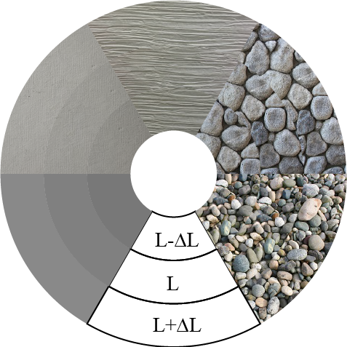
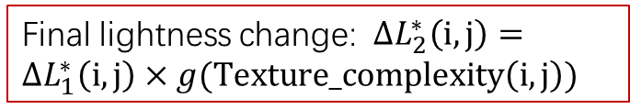
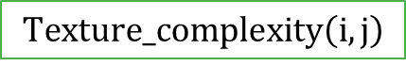
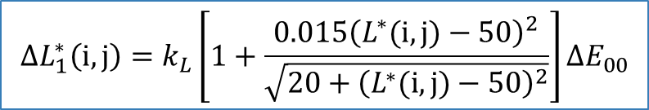
Achieving Fully-Imperceptible
Spatially Adaptive Embedding
Outcome-based Lightness Change Derivation:
Our solution: CIELAB uniform color space with CIEDE2000 formula (the latest and most accurate color difference formula):
Texture-based Lightness Change Adaptation:
Decrease lightness change in smooth regions where flicker is more noticeable:
$$ΔL_{1}^{∗}\left(i,j\right)=k_{L}\left[1+\frac{0.015{\left(L^{∗}(i,j)−50\right)}^{2}}{\sqrt{20+{\left(L^{∗}(i,j)−50\right)}^{2}}}\right]ΔE_{00}$$
$$Texture_complexity\left(i,j\right)$$
Desired lightness changes
Expected color difference
Lightness changes are more noticeable in smooth regions
Lightness changes are less noticeable in textured regions
Final lightness change: $ΔL_{2}^{∗}\left(i,j\right)=ΔL_{1}^{∗}\left(i,j\right)×g(Texture_complexity\left(i,j\right))$
Notes:
More specifically
We choose CIELAB uniform color space along with CIEDE2000, the latest and most accurate color difference formula currently available. CIEDE2000 color difference formula inspires us that, instead of using a fixed lightness changing amount,
We should choose an expected color difference amount,
And calculate desired lightness changes using CIEDE2000 formula. This leads our outcome-based lightness change derivation based on lightness of single pixel.
What’s more, as previous studies show that
Lightness changes are more noticeable in smooth regions,
While less noticeable in textured regions,
We further calculate regional texture complexity,
And decrease lightness changing amount in smooth regions basing on their texture complexity, to get our final lightness changing amount.

Slide 12
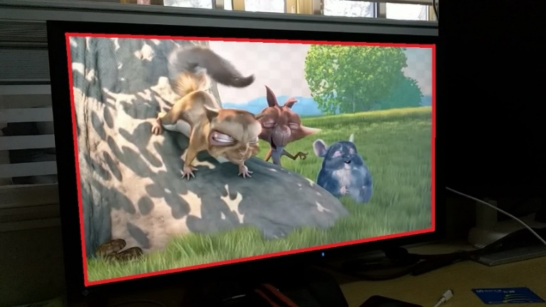
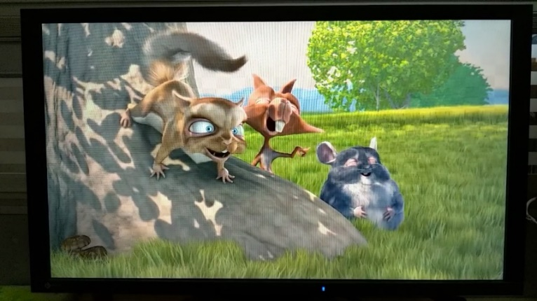
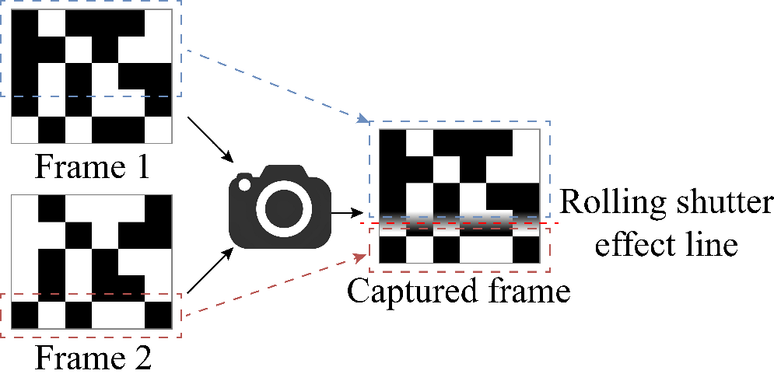
Achieving Reliable High Throughput
Challenges:
Projection distortion
Moiré pattern
Rolling shutter effect
Notes:
To achieve reliable high throughput data frame transmission, we need to deal with challenges including
Projection distortion
Moire pattern
And rolling shutter effect. Projection distortion makes the shape of our data frame into an irregular quadrilateral. Moire pattern leads to random errors. And rolling shutter effect can make the captured frame by camera in fact contains two neighboring origin frames, and also leads to burst errors near the rolling shutter effect line.

Slide 13
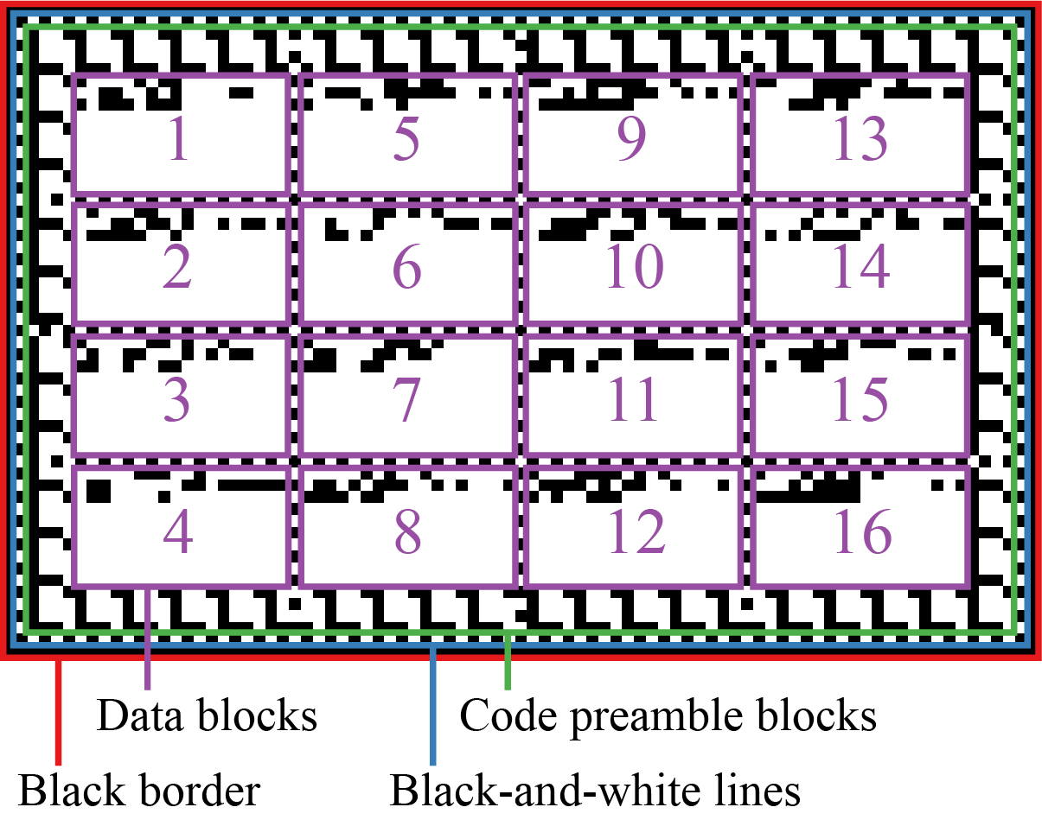
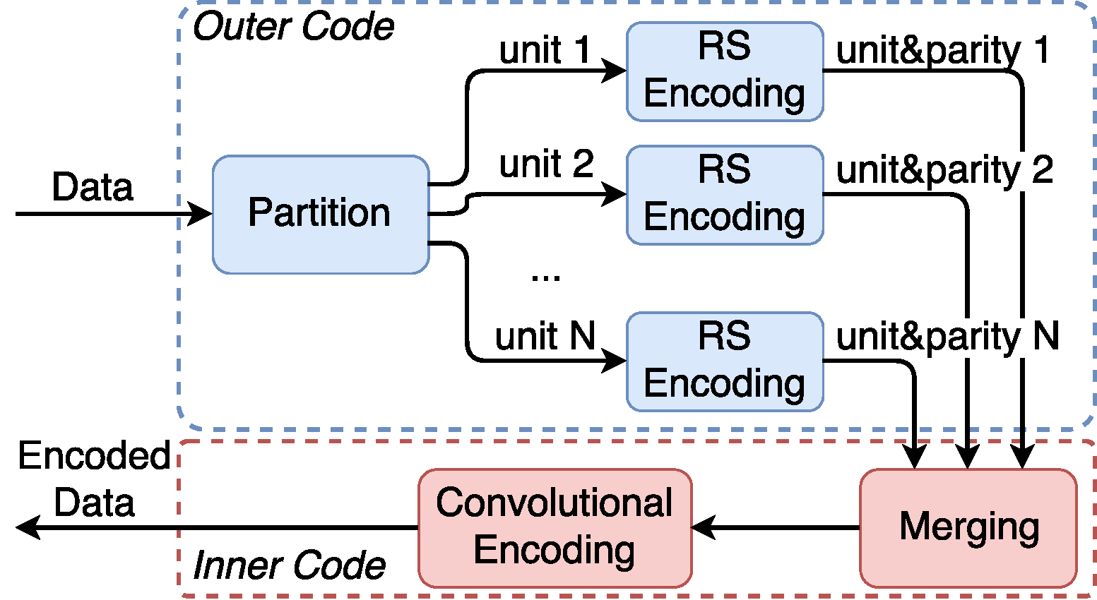
Achieving Reliable High Throughput
Full-frame embedding
One cell encoding one bit
Error correction code scheme: Reed-Solomon code + convolutional code
Interleaving to deal with burst errors
Eliminate various channel distortions
Notes:
We elaborately designed our data frame to handle those challenges.
We do full-frame embedding, and use one data cell encoding one bit to ensure high throughput.
We achieve reliable communication with concatenated encoding that takes advantages of both convolutional encoding and Reed-Solomon encoding. We use interleaving technique to transform burst errors into random errors, and eliminate various channel distortions by projection transformation and Moire pattern removal, etc.

Slide 14
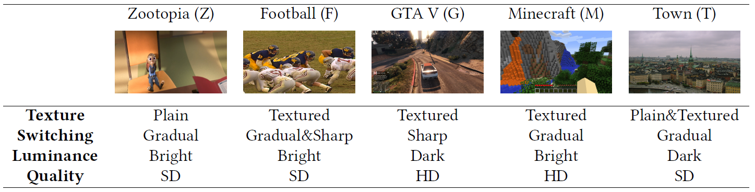
Evaluation
User study: participants give scores for invisibility
Data transmission: measure raw throughput, data goodput and BER
Representative primary video clips and tags used in the experiments
Notes:
Our evaluation contains two major parts, a user study part that evaluates the user perceived data hiding quality and a data transmission benchmark that measures the throughput and BER under various conditions. We select a group of videos as primary videos for experiments. A key consideration during the video selection is to find a set of representative videos with various characteristics, e.g., incorporating both plain and textured frames, involving both sharply and gradually switching scenes, containing both dark and bright scenarios, and covering both high and standard video qualities.

Slide 15
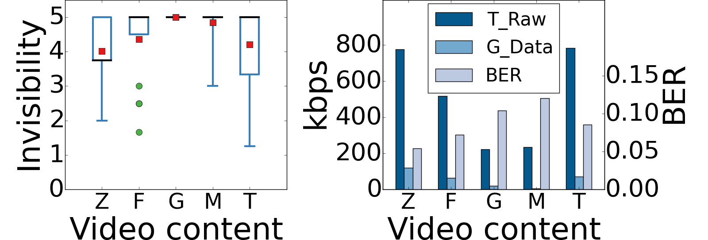
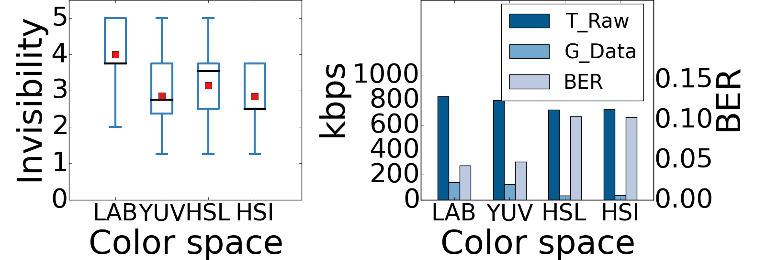
Evaluation
Impact of video sources and color space
Videos with higher texture complexity usually achieve better invisibility, but also lower raw throughput (T_Raw) and data goodput (G_Data), and higher BER.
CIELAB uniform color space indeed yields significantly better invisibility than the other color spaces, without downgrading the data transmission performance
Notes:
We firstly evaluate the results on different source videos. In short, videos with higher texture complexity usually achieves better invisibility, but also lower throughput and higher BER. We also compare differences between CIELAB uniform color space and three non-uniform color spaces, experiment results show that CIELAB uniform color space indeed yields significantly better invisibility than the other color spaces, without downgrading the data transmission performance.

Slide 16
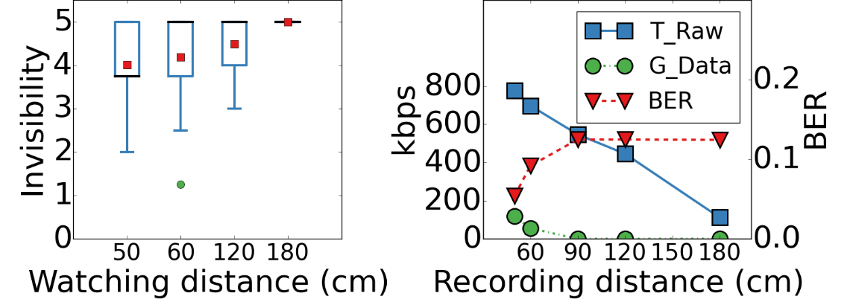
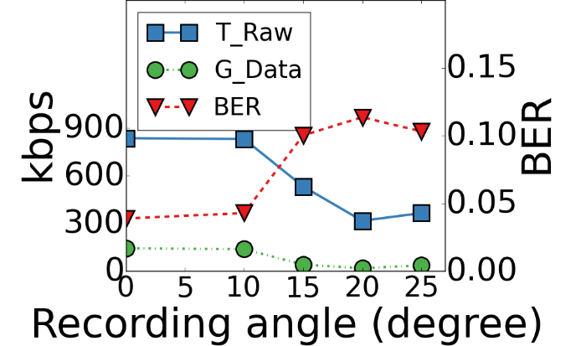
Evaluation
Impact of distance and angle
Invisibility is better under larger distance, But throughput and BER get worse under larger distance or angle.
Larger data cell sizes or screen sizes will improve data transmission performance over long distances.
Notes:
We measure how distance and angle affect invisibility and communication. We can observe that invisibility is better under larger distance, But throughput and BER get worse under larger distance or angle. However, larger data cell sizes or screen sizes will improve data transmission performance over long distances.

Slide 17
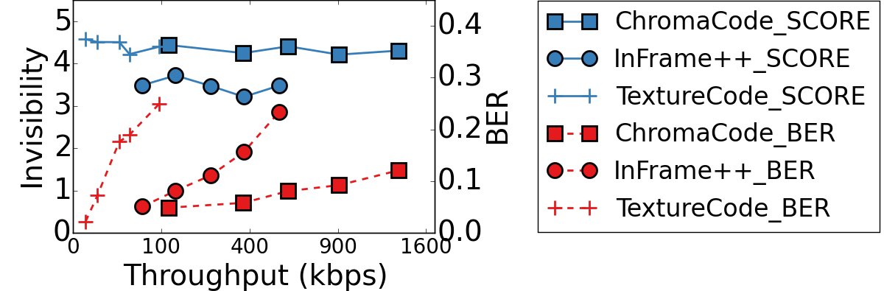
Evaluation
Comparative Study
ChromaCode achieves superior performance over previous schemes in terms of invisibility, throughput and BER.
Notes:
We compare the performance of ChromaCode with two state-of-the-art approaches, InFrame++ and TextureCode. As shown by the plus markers, although TextureCode retains graceful invisibility consistently, the throughput it can achieve is considerably low because TextureCode does not embed in plain regions. Circle markers show that although InFrame++ achieves rather high throughout, its invisibility is not good enough. ChromaCode achieves superior performance over previous schemes in terms of invisibility, throughput and BER.

Slide 18
Conclusion
We present ChromaCode, a system that achieves all three goals on unobtrusive, high-rate, reliable screen-camera communication.
We prototype ChromaCode and evaluate it by experiments. The results demonstrate its superior performance over previous schemes in terms of invisibility, throughput and BER.
Notes:
To summarize, we present ChromaCode, a system that achieves all three goals on unobtrusive, high-rate, reliable screen-camera communication. We prototype ChromaCode and evaluated it by experiments. The results demonstrate its superior performance over previous schemes in terms of invisibility, throughput and BER.

Slide 19
Thanks! For more information, please refer to our ACM MobiCom’18 paper.
Notes:
That’s all, thank you!

Slide 20
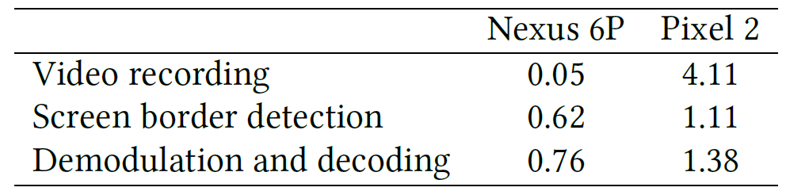
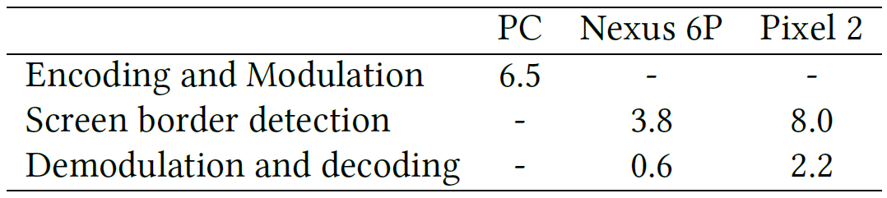
Evaluation
Energy consumption and Encoding/Decoding speed
Energy consumption (W)
The more powerful Pixel 2 achieves faster decoding speed, but also has higher energy consumption.
Distinction between Nexus 6P and Pixel 2 on energy consumption distribution is observed.
Encoding/Decoding speed (fps)
Notes:
We also compare energy consumption and decoding speed mainly on two smartphones Nexus 6P and Pixel 2. The more powerful Pixel 2 achieves faster decoding speed, but also has higher energy consumption. We also observed distinction between Nexus 6P and Pixel 2 on energy consumption. Pixel 2 costs more energy in video recording than in decoding, while Nexus 6P costs less. We think this should be caused by OS and camera hardware distinction between these two devices.

